Slide 1
How implementing ideas from The Happy Manifesto increased profits

Slide 2
How implementing ideas from The Happy Manifesto increased profits

Slide 5
2001 – 2010
Pre Happy Manifesto

Slide 9
“Creating a Great Workplace Makes Good Business Sense”

Slide 10
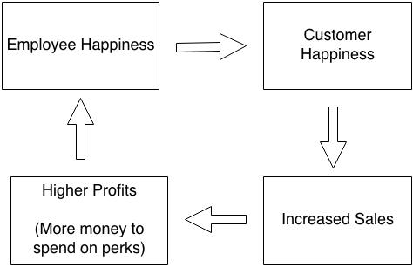

Slide 11
Celebrate
Mistakes

Slide 12
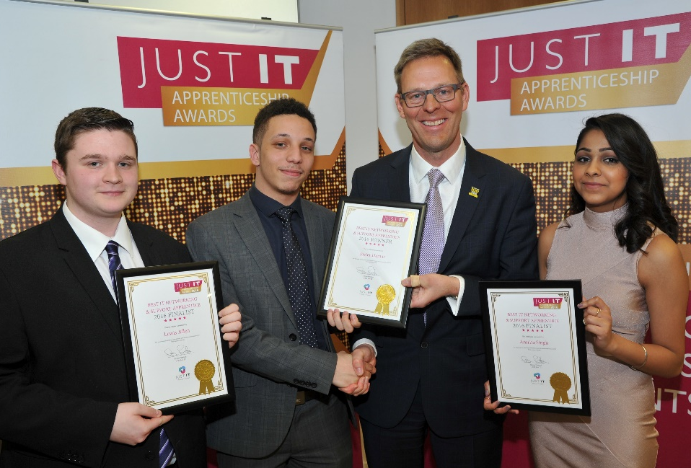
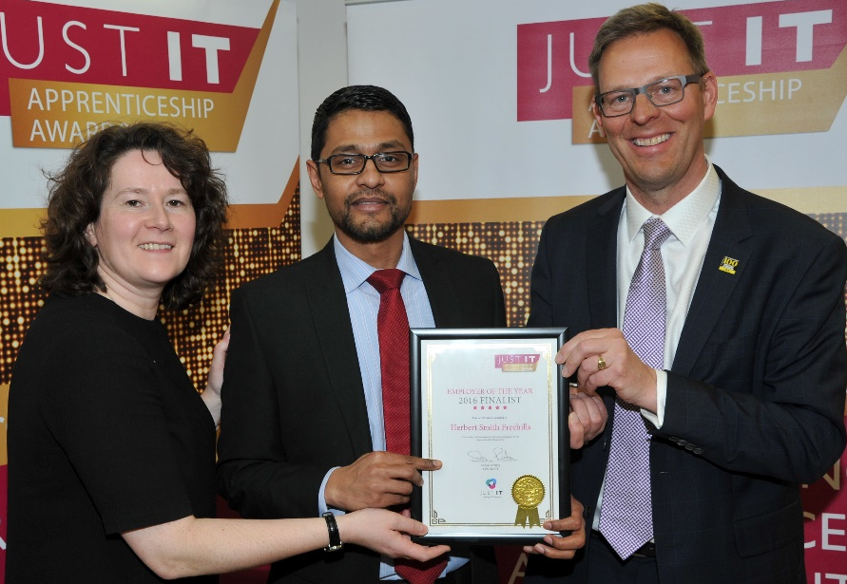
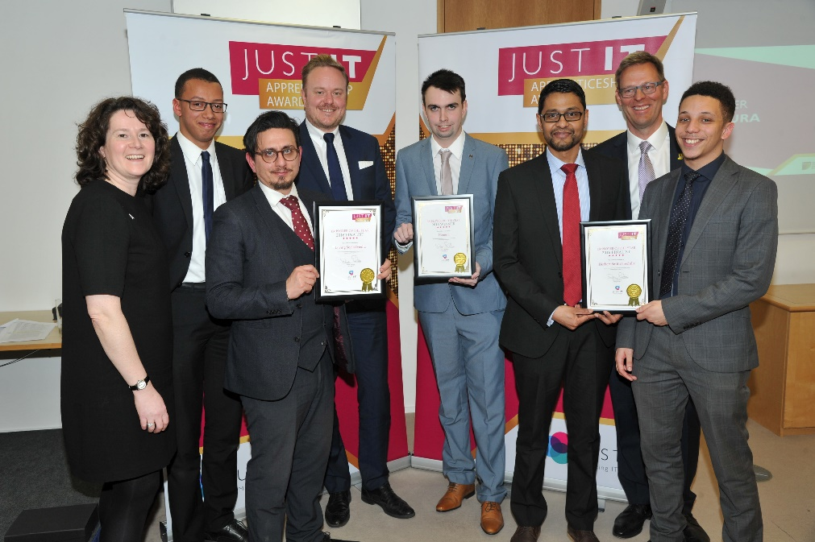

Slide 13
“Select Managers who are Good at Managing”

Slide 16
“Make Your People Feel Good”

Slide 18
“Enable People To Work At Their Best”

Slide 20
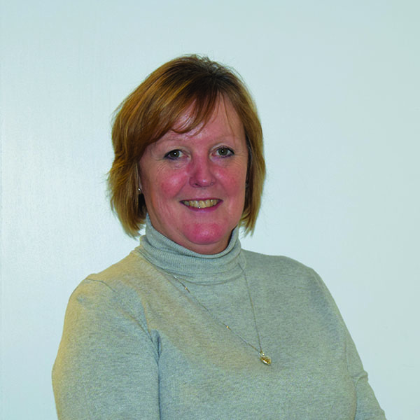

Slide 21
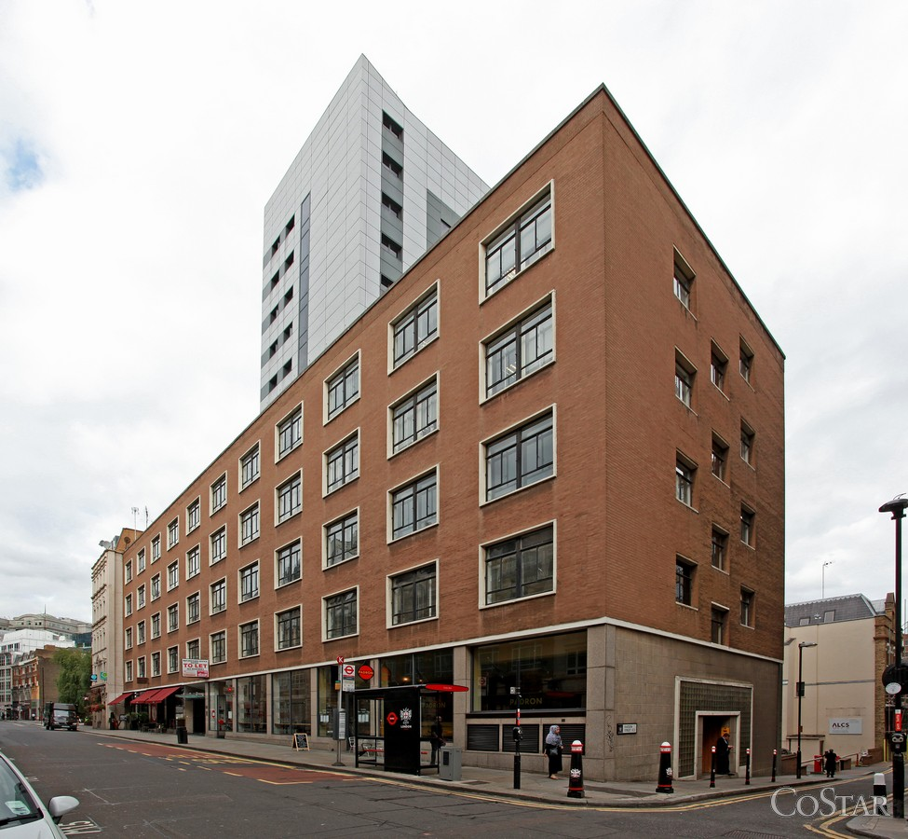

Slide 22
“Be Open And Transparent”

Slide 23
Let’s
Talk

Slide 24
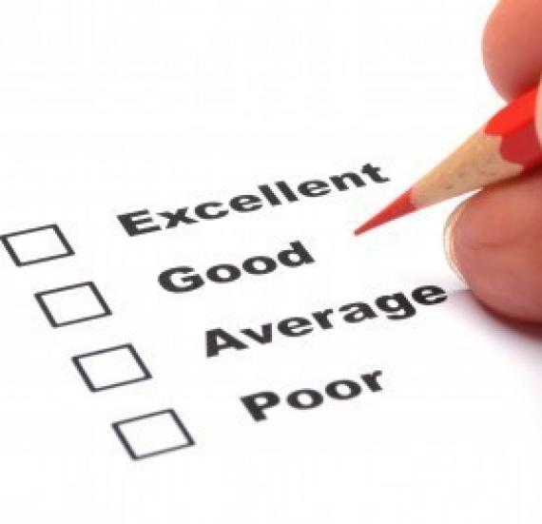

Slide 25
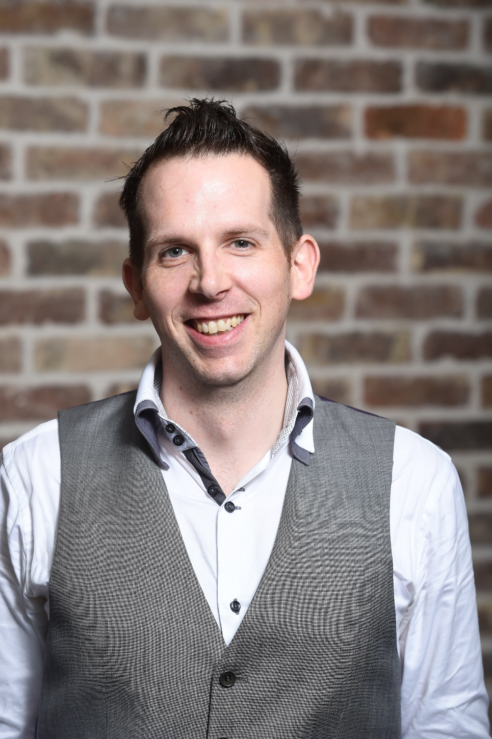

Slide 26
Recruit for Attitude, Train for Skill

Slide 27
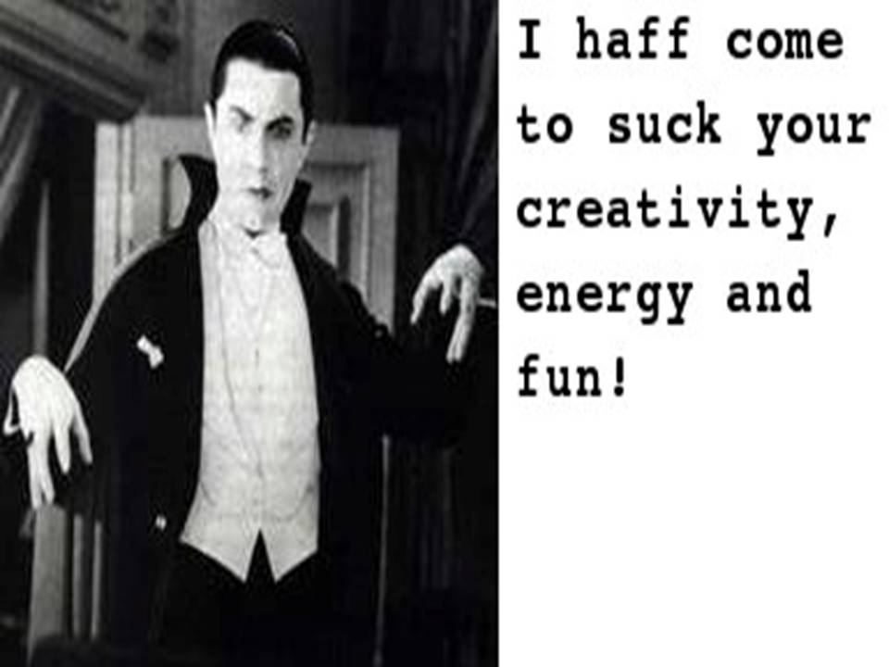

Slide 30
“Freedom within Clear Guidelines”

Slide 31
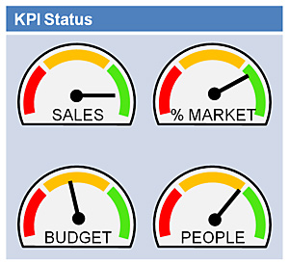

Slide 32
Community - Create mutual Benefit

Slide 34
Love Work, Get a Life

Slide 35
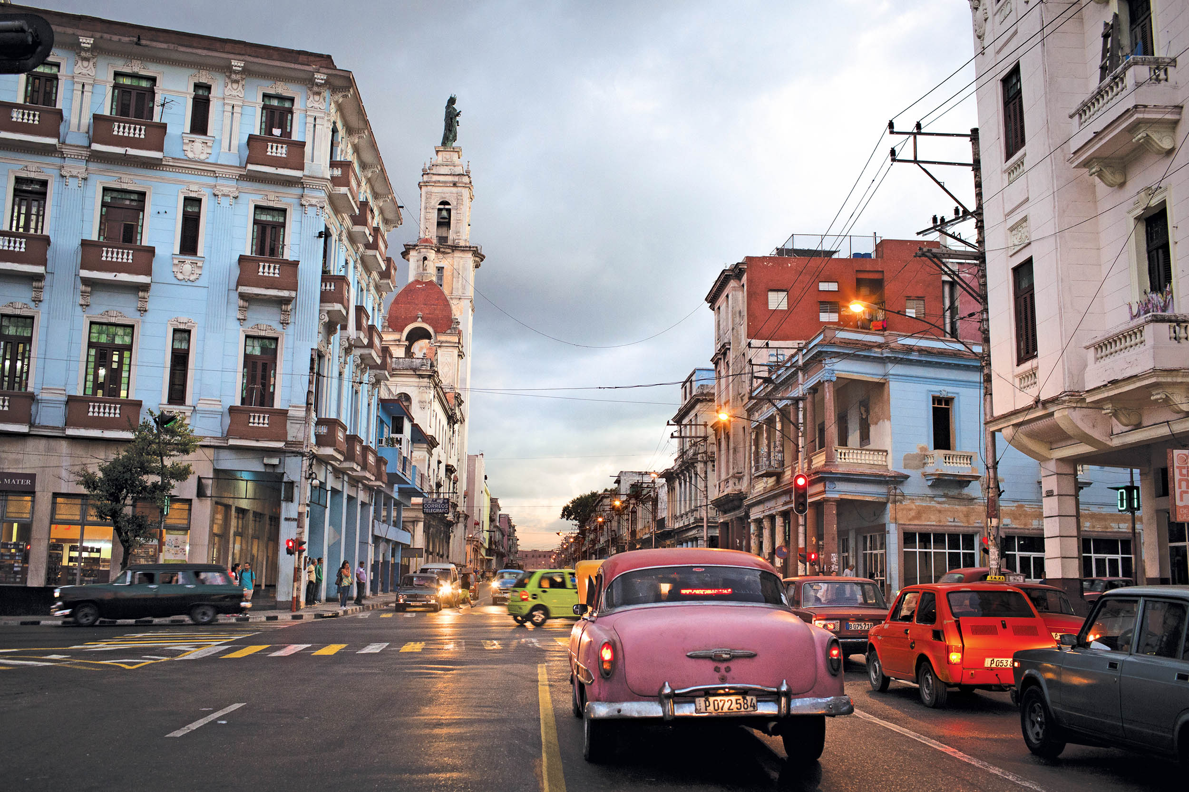

Slide 36
2010 – 2016
Post Happy Manifesto

Slide 37
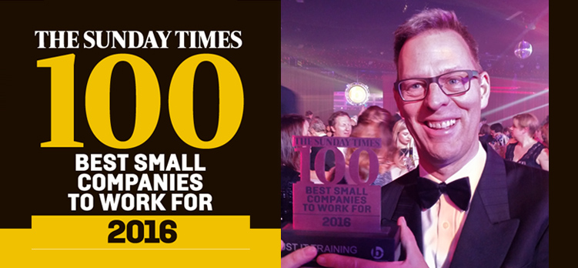

Slide 40
2016 – 2019
The Future

Slide 41
Talk to Me
Call: 07939277308
Email: simonp@justit.co.uk

