Slide 1
Global action plan
An explanation of our happiness
(with photos of monkeys and other animals)

Slide 2
Talking points
A bit about me
A bit about GAP
Five top tips
Harvest and challenges

Slide 3
Mission driveN
To inspire people to take action today to reduce their impact on the planet
People power A fundamental part of the solution
Choice Conscious behaviour changes important for the long game
Big solutions
Can be simple behaviours changed at scale

Slide 4
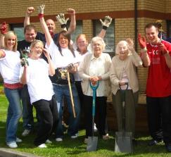
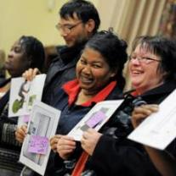
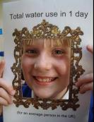
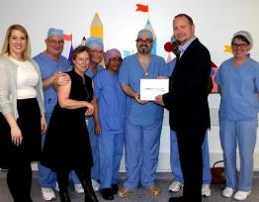
Finding change agents
Young & old
@ home,
school, work or play

Slide 5
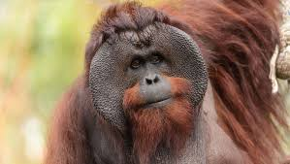
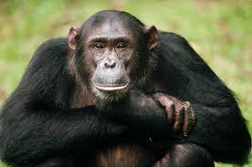
Change comes from our individual skills, together

Slide 6
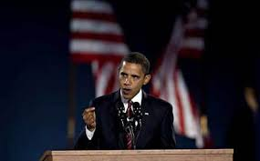
“Change will not come if we wait for some other person or some other time. We are the ones we've been waiting for. We are the change that we seek.” Barack Obama

Slide 7
Why is GAP A PARTNERSHIP?
Founder leaving
Scale of the challenge
Board ambition
Creating future leaders
Imagining differently
Greater impact

Slide 8
New ways of working

Slide 9
Top tips

Slide 10
Name and share the niggles
Problem solving awaydays
Development Group health check
1-10 in project meetings

Slide 11
Give time and thanks
Development sessions
Thank you board and staff hero
GAP alumni
Easter eggs to Xmas vouchers

Slide 12
Small things add up
Office dogs
Birthday buddies and leaving creeps
Office amazification
Ping pong and rounders

Slide 13
Not knowing is ok
Changing job titles and promotion paths
Delegation and empowerment
Catalyst youth unemployment programme

Slide 14
The HARVEST
Anything becomes possible
More brains = more ideas
Leadership meaning many things
Shared responsibility to fix what is broken
No-one to copy = listen to our instincts
My job is fun and creative

Slide 15
The challenges
Explaining our structure!
Finding people who are comfortable with creating their own reality
Getting the learning and development right
Embedding trust and releasing control
Not getting distracted by shiny things

Slide 16
what would be the scariest thing to try in your organization? What would be the most exciting?

Slide 17
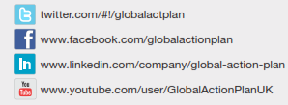
THANK YOU
Philippa Ward
Partner
T: +44 207 420 4437
E: philippa.ward@globalactionplan.org.uk

