Slide 1
Performance Management in VELUX
BBRT meeting 3 November 2015
Ulrich Gammelgaard

Slide 2
A few facts about me….
Ulrich Gammelgaard
13 years with VELUX
Head of Global Financial Management
Financial management
Business Partnering
Planning and Analysis
Product costing
Business Intelligence

Slide 3
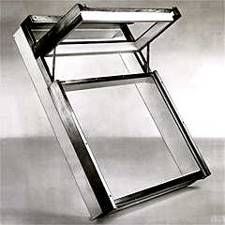

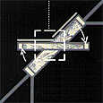
VELUX Roof Window
VELUX roof window was developed and named in 1942
for ventilation and
for light
Vision: ”To develop a roof window which in any aspect is as good as the best vertical window”
The pivot hinge was developed in 1945

Slide 4
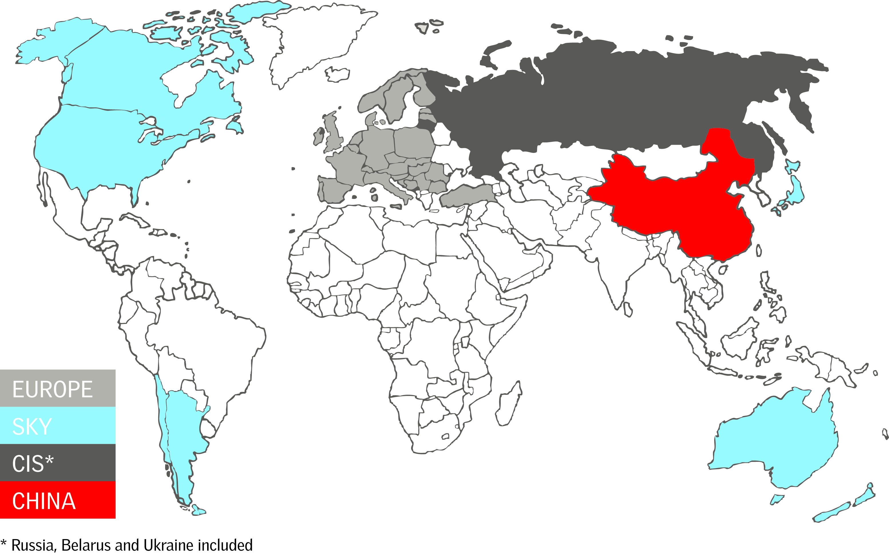
40 sales companies and production companies in 11 countries

Slide 5
Financial Management in VELUX
Global Finance transformation in 2012-2013: How can Finance create more value for Business?
Performance Management without budgets from 2014:
  Accountability
  Agility
  Transparency

Slide 6
VELUX finance organisation -> 2012
Before transition VELUX had 55+ separate finance functions in and being part of local group functions, sales- or production companies
Americas
4 Countries
1 PCOs
4 SCOs
Western Europe
12 Countries
13 PCOs
12 SCOs
VFC + Group
Eastern Europe
16 Countries
6 PCOs
16 SCOs
Asia
4 Countries
1 PCOs
4 SCOs
PCOs = Production companies
SCOs = Sales companies

Slide 7
Moving from 50+ finance departments to one global finance organisation in VELUX
VELUX Global Finance

Slide 8
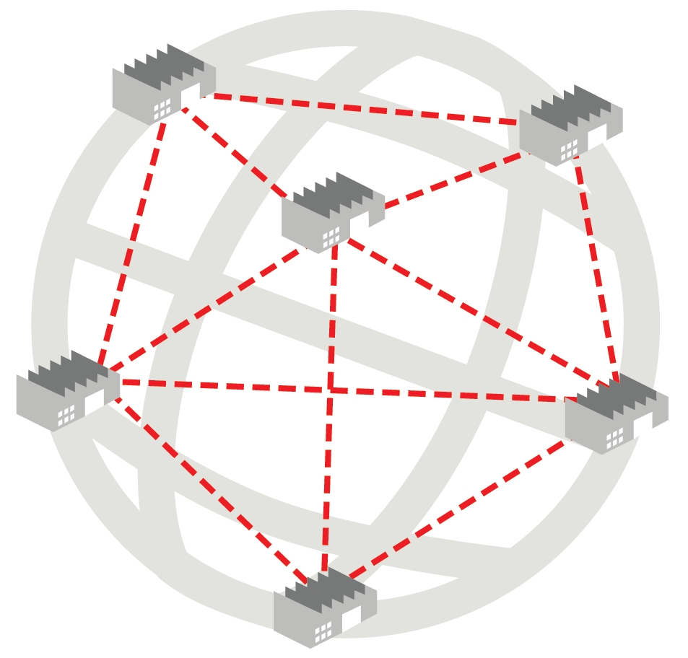
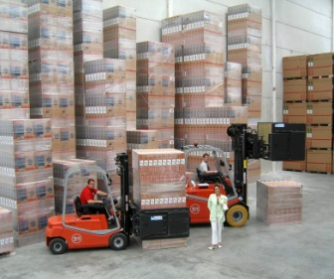
VELUX Performance Model
Wholesales & support
Production companies
Sales companies
Sales prices
Gross/Net turnover
Trade conditions
Production standard costs
Product mix
Raw materials
Other prod. cost
Logistic standard costs
Product mix
Contribution I
Products
Local marketing cost
Customers
Contribution II
Group costs:
D&D, Group-IT, Corporate marketing, Common logistics, HR, Finance, Group management etc.
Sales channels
Purchase price variance
Local cost of sales, overhead et.
Material variance
Market contribution
Labor variance
Allocated Group cost
Overhead costs variance
Depreciation cost variance
Market EBIT
Other variance
Group cost variance
Sum of all Market EBIT
Group EBIT

Slide 9
VELUX Performance Process
: We decided to leave the traditional budgeting process behind us
: We decided to implement a new common financial performance process in all of VELUX with distinct:
Target setting
Forecasting
Resource allocation

Slide 10




We go beyond budgeting!
Past:
Traditional budget planning once a year...
Future:
Adaptive process with target setting and rolling forecasting...
Target setting
Yearly
: One yearly planning process
: Monthly follow up on deviations
Forecasting
Monthly
Resource
allocation
Daily

Slide 11

What’s in it for VELUX?
With VELUX Performance Process we introduce a synchronised “beat of the pulse” for planning and follow up in VELUX.
-> Alignment of global targets with local targets
-> Agility in planning with possibility for monthly reviews
-> Forward looking follow-up on target realisation

Slide 12

VELUX Performance Process
1: Global target setting
2: Break-down of targets
Input: | Strategic plan, initiatives etc.
Horizon: | 1-2 year
Timing: | June-September
Who: | VELUX Management, BoD
Purpose: | Link strategy to performance management
Example: | EBIT-%
Input: | Global target (step 1)
Horizon: | 1-2 years
Timing: | June - September
Who: | VELUX Management and management teams
Purpose: | Link targets to business structure
Examples: | Market Contribution in D, F, GB, USA, E27 Market share Production cost efficiency
4: Monitor and follow-up
3: Plan to reach target
Input: | Plans defined in step 3
Horizon: | Current and next year
Timing: | Monthly
Who: | Management in cooperation with Finance
Purpose: | Review performance and develop forecast
Examples: | Follow up on actual and forecasted performance Define new actions to address gap (if any) More trend reporting and forward looking
Input: | Targets (step 2)
Horizon: | 1-2 year
Timing: | October/Monthly
Who: | SCo, PCo, Business support
Purpose: | Develop plan and commitment to reach targets
Examples: | Planning supported by simulation tool Actions, initiatives, financial impact Operational plans

Slide 13

VELUX Performance Model
Production companies
Group support
Sales companies
Sales prices
Gross/Net turnover
Trade conditions
Production standard costs
Product mix
Raw materials
Other prod. cost
Logistic standard costs
Product mix
Contribution I
Products
Local marketing cost
Customers
Contribution II
DAGC:
D&D, Group-IT, Corporate marketing, Common logistics, HR, Finance, Group management etc.
Sales channels
Purchase price variance
Local cost of sales, overhead et.
Material variance
Market contribution
Labour variance
Allocated DAGC
Overhead costs variance
Depreciation cost variance
Market EBIT
Other variance
Group cost variance
Sum of all Market EBIT
Group EBIT

Slide 14
VELUX Performance Model
Production companies
Group support
Sales companies
Sales prices
Gross/Net turnover
Trade conditions
Target
Production standard costs
Product mix
Raw materials
Other prod. cost
Target
Logistic standard costs
Product mix
Contribution I
Products
Local marketing cost
Customers
Contribution II
DAGC:
D&D, Group-IT, Corporate marketing, Common logistics, HR, Finance, Group management etc.
Sales channels
Purchase price variance
Local cost of sales, overhead et.
Target
Material variance
Market contribution
Target
Labour variance
Allocated DAGC
Overhead costs variance
Depreciation cost variance
Market EBIT
Other variance
Group cost variance
Sum of all Market EBIT
Target
Group EBIT

Slide 15



Financial Target-KPI’s
Sales Companies
=
Market Contribution-%
Production Companies
=
Production costs development (standard cost + variances YoY)
Logistics
=
Logistic costs development (standard cost + variances YoY)
Support & Group Systems
=
DAGC in % of net sales
Group:
VELUX EBIT-%

Slide 16
New process and new roles
For all business units (in SCo, PCo, Business Support and in PRD) management have to organise a monthly process following the “beat of the pulse” in VELUX
New simulation tools has been developed to support financial planning and monthly forecasting
Follow-up on financial KPI’s for target setting will be done in user-friendly dash-boards, showing actual development, targets and updated forecasts for current year and next year
All Finance Managers have been trained in these tools and will back-up the local process of planning and follow-up.

Slide 17
Monthly process
Beginning of month
Every month a “window” will be open for financial planning and forecasting in the new simulation tool.
Based upon the actual figures year to date/trends for last 12 months etc. you as manager have to decide if there will be changes to:
  Expectations for unit sales
  Expected changes in pricing (GSP, discounts)
  Expectations to cost development
  Investment activity
  Etc…
When a forecast is submitted, data will be available in the monthly dashboards for relevant stakeholders
Managers should anchor the monthly forecasting process in the local management team (monthly meetings etc.), using the finance manager/finance business partner as “expert” in using the tools and support decision making.
Actual data available in dash boards
Planning window
Submit forecast
End of month

Slide 18
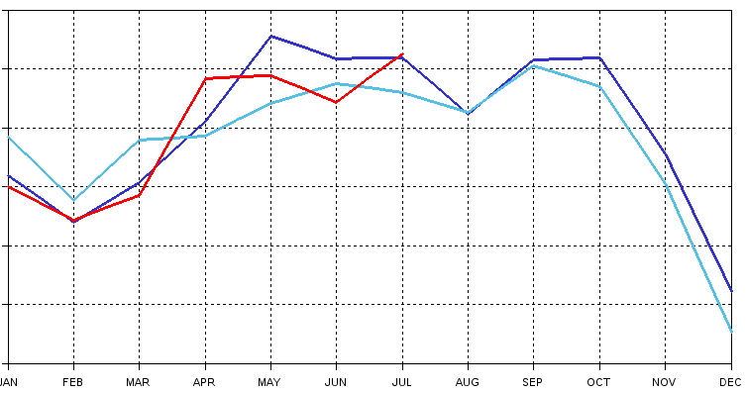
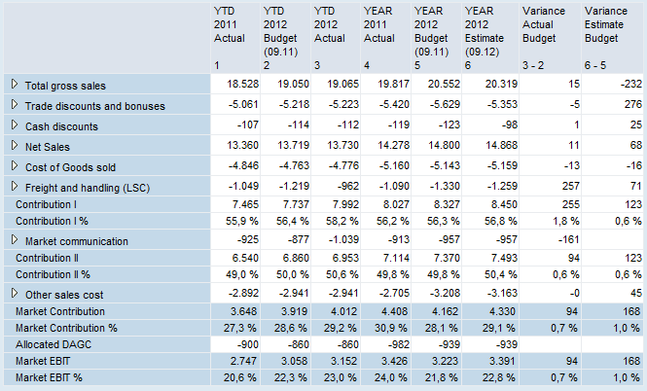
System view: Rolling forecasting
Monthly forecasting rolling for current year and next year
BPC on SAP Hana technology allows real time simulation of full P&L, supported by statistical forecasting with ”big data”
Scenario analysis as an option before a forecast is ”submitted”
Seamless integration from sales forecasting to production planning and logistics operations (One forecast)
Forecasting

Slide 19
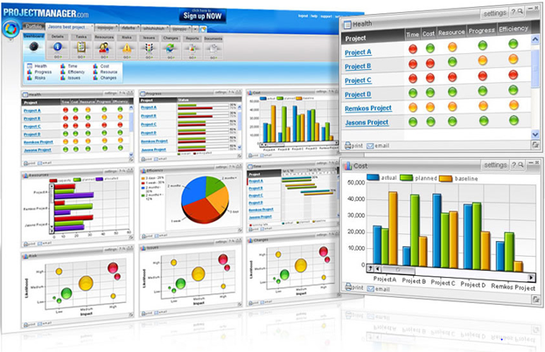

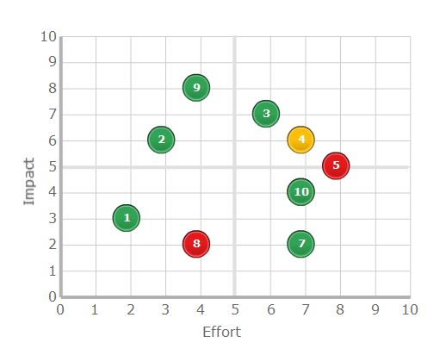
System view: Rolling forecasting
Performance data incl. rolling forecast data available in dashboards for all business units/accountable managers
Trend focus with “story line” looking forward in terms of expected performance (sales, financials)
Risks and initiatives in relation to expected performance are included
Dashboards
Trend focus
Risks/initiaves

Slide 20
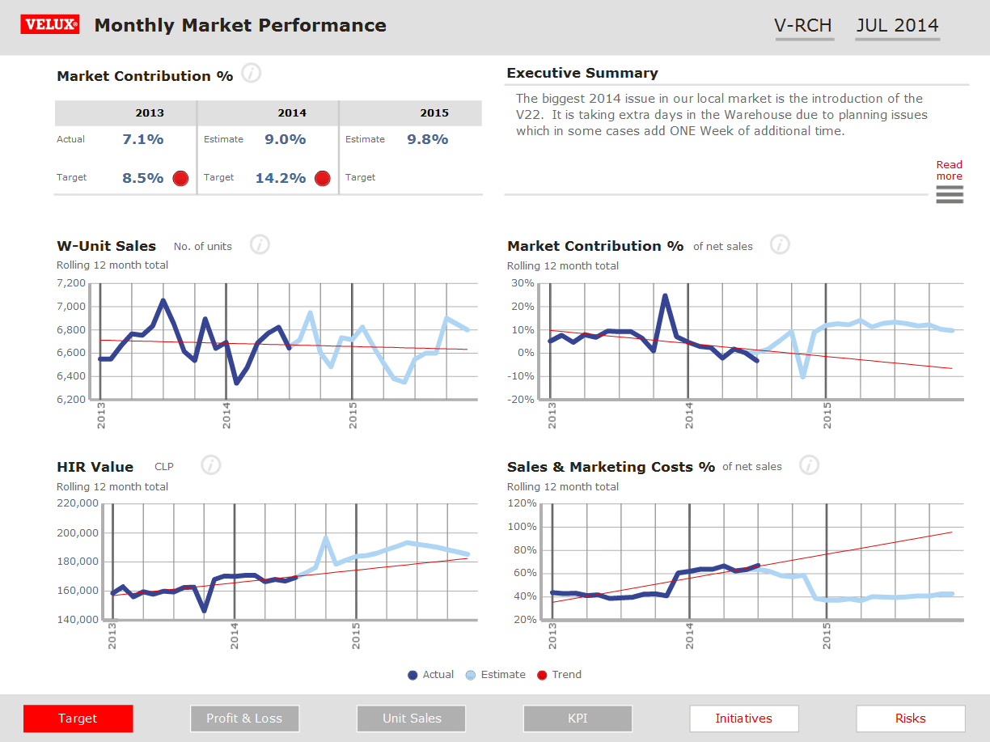
Dashboard Market Performance
Rolling 12 months average and trend lines shows historical development up against current forecasts.
Target-KPI has a predominant position
Commentary, initiatives and risks included
Layout optimized for Ipad
Notes:
Today we support:
+2000 users
+5.000 reports
7TB data
10+ data sources

Slide 21
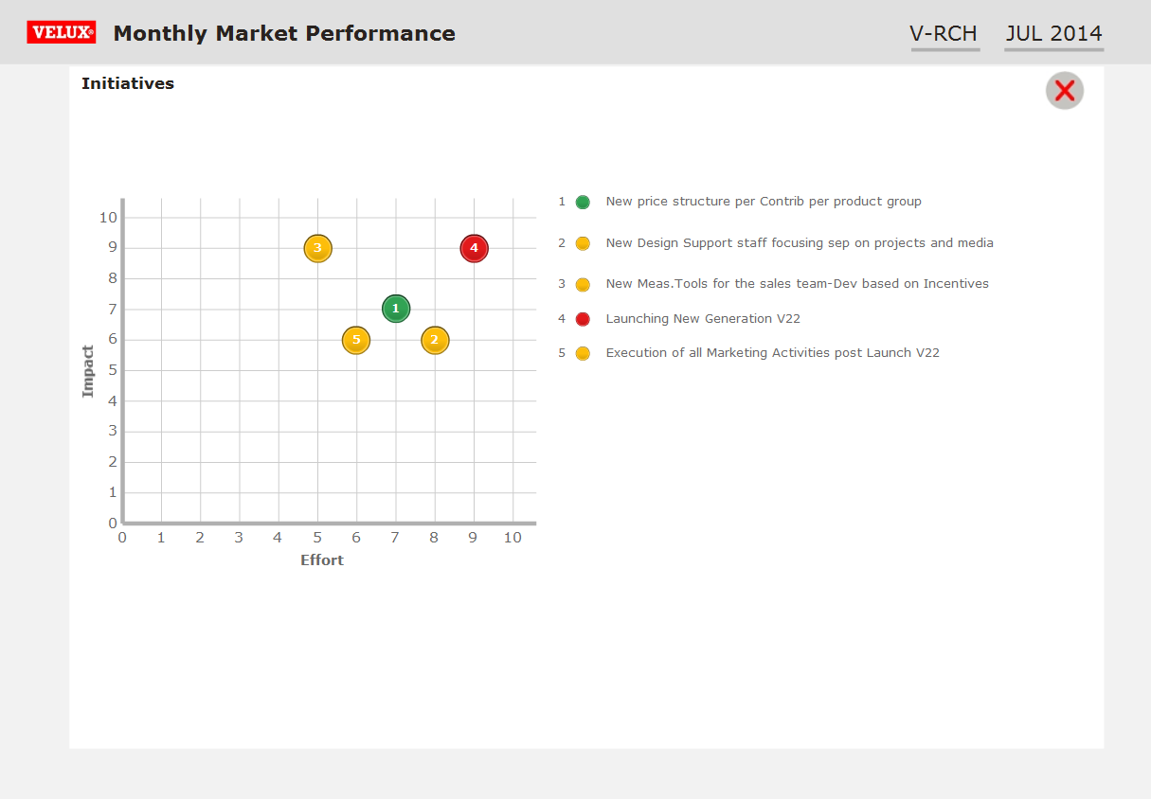
Dashboard Market Performance
Initiatives to reach targets are included to provide a more operational/strategic (however pragmatic) dicussion about plans/expectations
Notes:
Today we support:
+2000 users
+5.000 reports
7TB data
10+ data sources

Slide 22
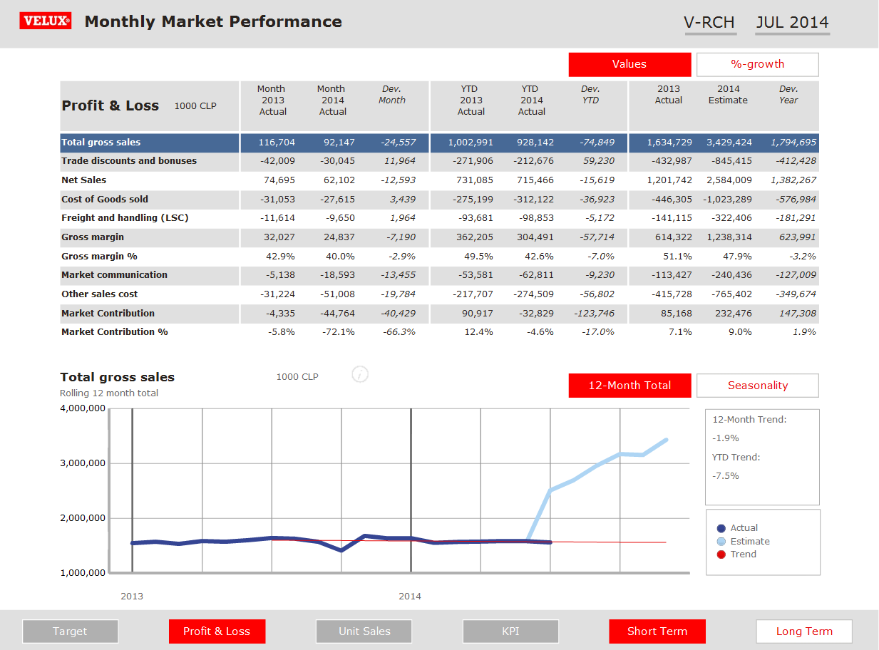
Dashboard Market Performance
Focus on actual and expected performance
Trends and rolling 12 month average graphics
Notes:
Today we support:
+2000 users
+5.000 reports
7TB data
10+ data sources

Slide 23
VELUX Performance Process
1: Global target setting
2: Break-down of targets
Input: | Strategic plan, initiatives etc.
Horizon: | 1-2 year
Timing: | June-September
Who: | VELUX Management, BoD
Purpose: | Link strategy to performance management
Example: | EBIT-%
Input: | Global target (step 1)
Horizon: | 1-2 years
Timing: | June - September
Who: | VELUX Management and management teams
Purpose: | Link targets to business structure
Examples: | Market Contribution in D, F, GB, USA, E27 Market share Production cost efficiency
4: Monitor and follow-up
3: Plan to reach target
Input: | Plans defined in step 3
Horizon: | Current and next year
Timing: | Monthly
Who: | Management in cooperation with Finance
Purpose: | Review performance and develop forecast
Examples: | Follow up on actual and forecasted performance Define new actions to address gap (if any) More trend reporting and forward looking
Input: | Targets (step 2)
Horizon: | 1-2 year
Timing: | October/Monthly
Who: | SCo, PCo, Business support
Purpose: | Develop plan and commitment to reach targets
Examples: | Planning supported by simulation tool Actions, initiatives, financial impact Operational plans

Slide 24


TM
Notes:
Endslide, animated

