Slide 1
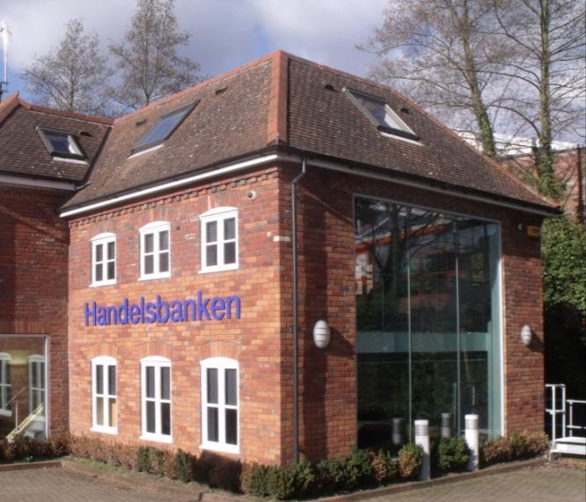
Handelsbanken UK Presentation to Beyond Budgeting conference Andy Copsey, COO UK
Low credit risks
Low costs
Local responsibility
Satisfied customers
SHB’s market

Slide 2
Handelsbanken in brief
Founded in 1871
Average loans to the public: SEK 1,808 billion (GBP 149 billion)
Operating profits: SEK 19.2 billion (GBP 1.70 billion)
11,700 employees
Operations in 25 countries
Over 830 branch offices worldwide
As per 2014 Annual Report

Slide 3
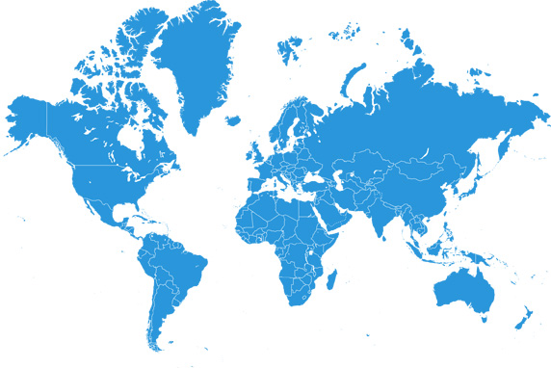
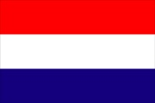
We have six home markets, and provide support worldwide
Sweden
463 branches
Norway
51 branches
Finland
46 branches
Denmark
57 branches
Great Britain
201 branches *
The Netherlands
23 branches
* Per 23 October 2015 (incl. Branch Managers appointed)
Outside its home markets, the bank has operations in 29 locations in 19 countries :
Branches: Representative offices:
USA (New York) Poland (Warsaw) Beijing Sao Paulo
Singapore Austria (Vienna) Jakarta Sydney
Germany Estonia (Tallinn) Kuala Lumpur Taipei
France (Paris, Nice) Latvia (Riga) Marbella Zürich
Greater China (Hong Kong, Shanghai) Lithuania (Vilnius) Moscow
Luxembourg Mumbai

Slide 4
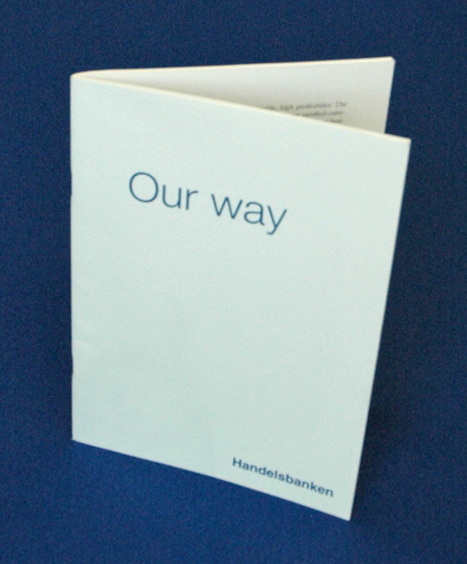
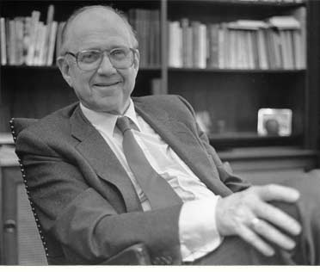
A devolved leadership model

Slide 5
Our corporate goal
A single, simple corporate goal: to attain a higher return on equity than the average of our competitors each year
This should be achieved through having:
More satisfied customers
Lower costs than peers
The corporate goal has been reached for the past 43 years

Slide 6
The essence of Handelsbanken
“Work with human nature”
“Take the long-term view”
Values, not command and control
Lasting relationships, not transactions
Local knowledge and responsibility
Prudence and financial stability
Customer focus
Responsible member of the community

Slide 7
QUESTION
In a decentralised organisation where head office’s role is to provide support as close to the customer as possible, what could your company's organisational chart look like?

Slide 8
Devolved leadership in practice
The way we work:
Focus on customer meetings
Making decisions close to the customer
Local branches who know their customers
Central Departments and Business Areas
Regional
Banks
Branches
CUSTOMER

Slide 9
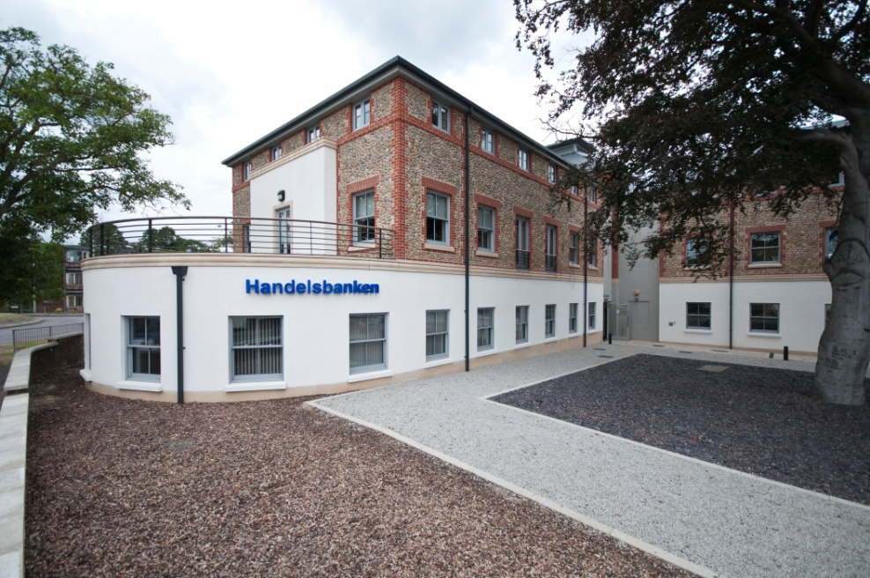
Geographical organisation
One branch = One geographical area = One P&L With:
Responsibility for all customers within its area
All revenues/costs allocated to the branch regardless of product or how and where the transaction was made
Supporting the branch the only task for central units
Easy for the branch to understand how it is contributing to group profitability

Slide 10
Handelsbanken in the UK – recent history
Handelsbanken has been in the UK since 1982, designating it a home market in 2002
Announced branches
January 2013 4th UK Regional Bank created
January 2011 3rd UK Regional Bank created
2008 2nd UK Regional Bank created
1 July 2002 UK became a Regional Bank
January 2015 5th UK Regional Bank created

Slide 11
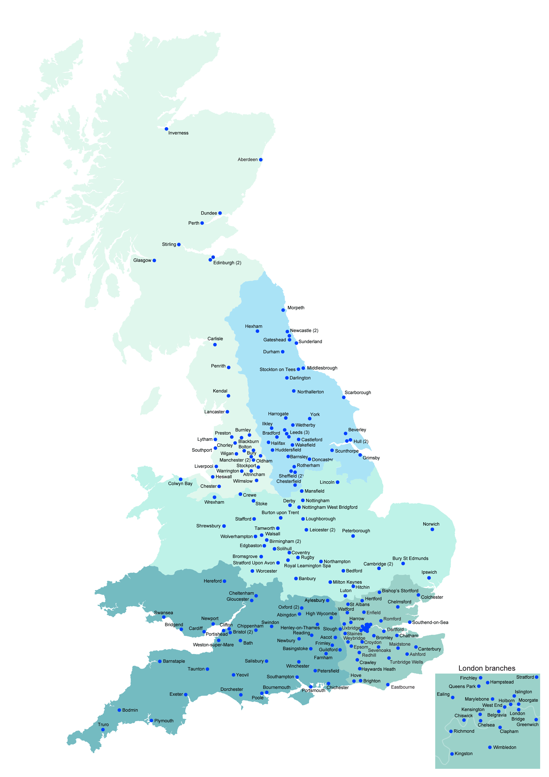
Our UK branch network
201* branches, including recruited managers
19 new branches opened in 2014
Expansion costs funded by UK operations
Year-on-year growth in lending Q3 2015:
UK lending increased by 13% to GBP 15.0bn
Household lending up 18% to GBP 4.9bn
Corporate lending up 11% to GBP 10.1bn
Year-on-year growth in deposits Q3 2015:
UK deposits taken increased by 11% to GBP 8.7bn
Household deposits up 37% to GBP 1.8bn
Corporate deposits up 6% to GBP 6.8bn
* Per 23 October 2015

Slide 12
How branches operate
“The Branch is the Bank”
The Branch Manager makes all decisions regarding:
Recruitment
Costs
Marketing, customer selection & management
Credits
Pricing
There are no sales or activity targets
No central call centres

Slide 13
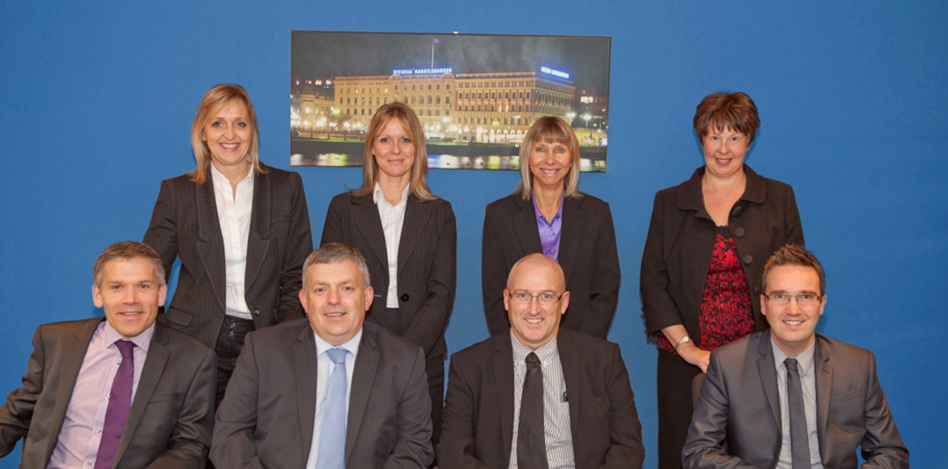
Huddersfield Branch – an example
Opened January 2008 with 4 staff
Now 9 staff with banking experience of 236 years
All staff live locally
Manufacturing town with population of 150,000
Broke even after 18 months

Slide 14
The most satisfied customers
Individuals
Businesses
Ranked top for customer satisfaction and loyalty, for the seventh year running, in an independent survey of UK bank customers.
Source: EPSI Rating UK 2015

Slide 15
Long-term shareholder value
Total return since 30 June 2007
%
Source: Factset

Slide 16
Model proved resilient throughout the latest crisis
Since the crisis began, average annual growth in equity (incl. dividends) of 15%; and no single quarter with RoE below 12%
No need for any kind of support, neither from government nor shareholders (just as with the banking crisis of the early 1990s)
Ranked one of the world’s strongest banks, by Bloomberg (July 2015)
Among lowest CDS spreads and highest credit ratings of any bank in the world throughout the crisis
Excellent liquidity and capital ratios, which have improved considerably more since the crisis began
Have been able to support our customers through the economic cycle

Slide 17
QUESTION
Given Handelsbanken’s focus on achieving our single, group-wide corporate goal*, what effect might this have on our approach to staff remuneration?
*To attain a higher return on equity than the average of our competitors each year

Slide 18
Oktogonen: our all-staff equal profit share scheme
If the Bank achieves its RoE goal, all staff receive an allocation of profit paid into the Oktogonen Foundation – the same sum for everyone
The Foundation invests these collected funds mainly in Handelsbanken shares (~90%), making Oktogonen one of the largest shareholders with >10%
No employee can withdraw their allocated units before they reach 60 years old
Oktogonen has 22,000 unit-holders across ten countries – all current or former employees

Slide 19
Oktogonen: an essential tool steering towards our core values
Everyday focus on long-term customer satisfaction, risk management and cost control
Corporate goal achieved → all staff allocated equal reward
Invested in Handelsbanken shares, until age 60
Genuine sense of ownership, influence, and responsibility

Slide 20
“Our advice must always be what is best for the customer, not what is most profitable for the bank at that time”

Slide 21
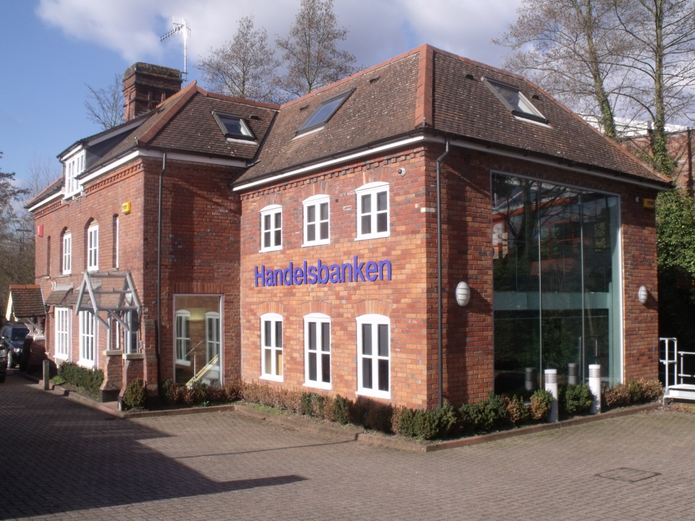
Q & A
Low credit risks
Low costs
Local responsibility
Satisfied customers
Our market

