Slide 1


Slide 2
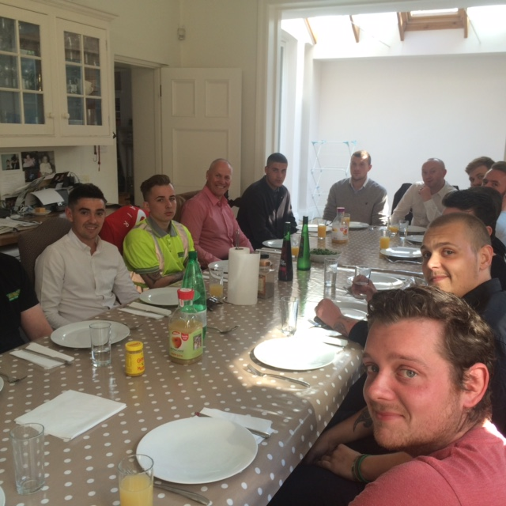

Slide 3
The Lawsons Family Mission
Lawsons vision, (and without a vision business will perish) is to make work as interesting and satisfying as possible.

Slide 4
The Lawson Family Values
Job Security & Honesty
Empowerment & Delegation
Training
A Sense of ‘Belonging‘
Good Working Conditions
Fit For Purpose Equipment
A Fair Package
Job Rotation & Promotion Prospects
Sponsored Events: Family Day, Children’s Christmas Party
Improved Communication
Give Something Back to the Community

Slide 5


















































‘Family Values - Professional Service’
Staff Benefits
All staff are eligible to join, once completed three months service Members required to contribute a minimum of 2% of your salary Lawsons will contribute 5% of your salary
A very competitive scheme
Pension Scheme
•
•
•
•
Income Protection
•
•
•
•
•
Available to you, once you have completed two years service
The insurance company will pay 60% of your salary (subject to PAYE & NI) Payments will commence after 26 consecutive weeks sickness absence Paid for a maximum period of ﬁve years
If you return to work part-time, you will still be eligible for part payments
Death in Service
•
We all hope that we would never need to draw upon this beneﬁt, but should the untimely event happen Lawsons will provide a cover which pays a lump sum of 2x your annual salary, paid to your beneﬁciary Please note, “Expression of Wish Form’ must be completed
•
Employee Assisted Programme
•
•
•
Helping you achieve a positive balance in your life • Available to both you and your immediate family members • Offering Financial, Legal & Relationship support (telephone / face • to face counselling) •
Contact: 0800 072 7072 www.icasxtra.com
User Name = lawsons Password = EAPlawsons
Child Care Vouchers
•
•
•
•
•
Vouchers for registered child care Beneﬁt via salary sacriﬁce
TAX & NI savings for working parents For children aged up to 16
Can be used for child minders, nurseries, play groups and out of school clubs
Cycle to Work Scheme
•
•
•
•
•
Cycling to work is a cost effective option, reducing commuting costs Allows you to purchase a bike (up to limit of £500 + £100 accessories) Beneﬁt via salary sacriﬁce (paid back over 12 months from gross salary) Regular exercise to keep you ﬁt and healthy
Helps reduce carbon footprint
Staff Purchase Scheme
•
Discounts are given on purchases made by staff for personal use
Staff Suggestion Scheme
•
•
Rewards are given for good ideas...
The simplest once are often the best (consider how the business will beneﬁt)
Entry forms available on the Lawsons Intranet site
•
•
•
Gold Award £100 vouchers Silver Award £50 vouchers Bronze Award £25 vouchers
•
Gifts to Staff
•
•
•
•
•
To help you celebrate your occasions Births (£50 store vouchers) Marriages (£200 store vouchers)
25 Years Service (£100 gift value)
Retirement (£100 gift value + celebratory meal with collegues)
Chairman’s Values Meetings
•
•
Invitation to Lunch prepared by Simon Lawson A chance to openly discuss any current issues
Profit Share Scheme
•
Chairman’s discretionary payment to staff

